Slide 1




SUPPLY CHAIN ANALYTICS
FOR BUSINESS OPTIMIZATION
Data-Driven Insights for Smarter Supply Chains

Slide 2

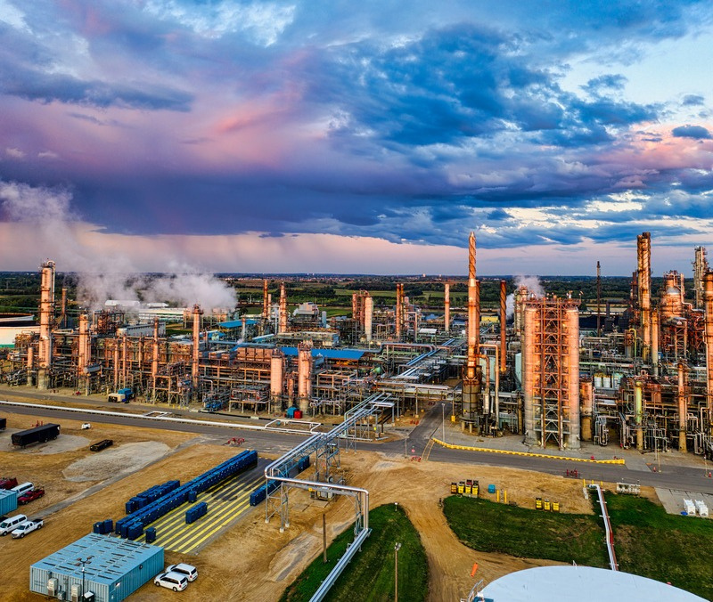

01
Team Members
Sohaila Ahmed Farouk (leader)
Hager Mohamed Metwally Noha Mohammed Elsaid
Alyaa Hamed Aly Hussein Esraa Mostafa Attia Zaghlal Sara Mohamed Hussein Hamdi

Slide 3


02
Introduction
In today’s fast-paced business environment, supply chainsare no longer just behind-the- scenes operations — they’ve become a critical factor in achieving competitive advantage. As markets grow more complex and customer expectations rise, data analytics has emerged as a powerful tool to help businesses make informed decisions, reduce costs, and improve efficiency at every stage of the supply chain.

Slide 4



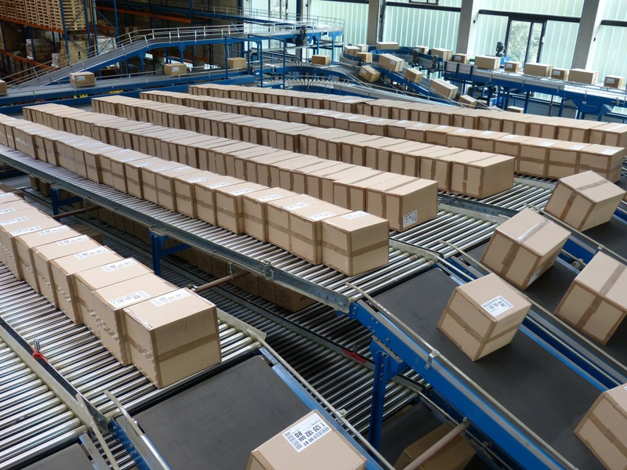
03
The Challenge
NavigatingSupplyChain Complexities
Modern supply chains are fraught with challenges, from unpredictable demand to escalating operational costs. Without clear insights, businesses struggle to optimize, leading to:
High operational expenses
Frequent
delivery
delays
and
customer
dissatisfaction Inefficient inventory management
These inefficiencies directly impact profitability and market competitiveness. Our goal is to transform raw empowering
data
into
actionable
intelligence,
managers to make informed decisions.

Slide 5





04
Our Objectives
our projectfocusesonkeyanalyticalobjectives designed to provide a comprehensive view .of supplychainperformance
Product & Customer Profitability
identify top-performing products and most valuable customer segments.
Supplier & Delivery Performance
Demand Forecasting
Evaluate supplier efficiency and analyze shipping costs and delivery times.
Predict future demand to optimize inventory and planning for better resource allocation .

Slide 6



05
Project Steps:
Define the Objective
Data Reading Data Cleaning
Exploratory Data Analysis
Visualize Results & Build Recommendations

Slide 7

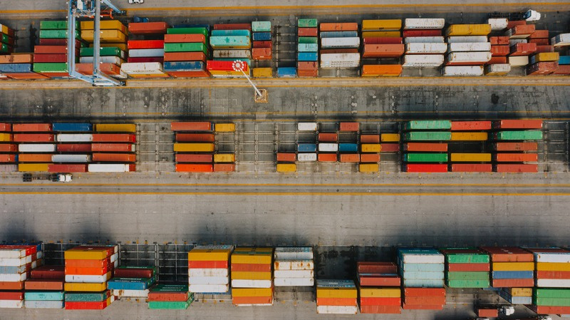

06
Data Findings
Initial Overview
Number of Rows: 180519 Number of Columns: 38 Data Type: Raw supply chain data including suppliers information, inventory levels, delivery information, orders, sales and profit, customers and markets.

Slide 8


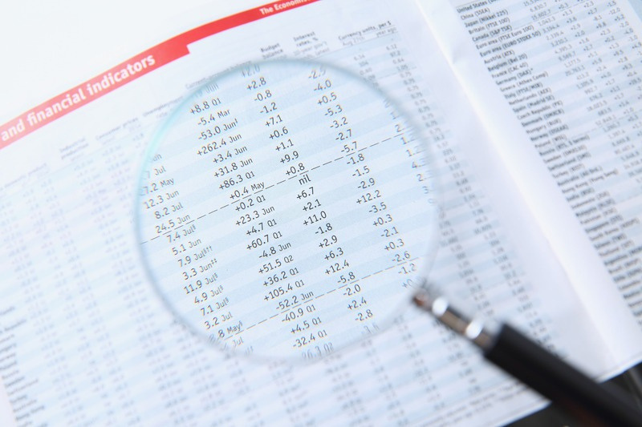

07
Data Findings
Byreading the excelfilebyusing PYTHON we can
determine the following:
Overall shape of the Dataset ( 180519 x 38)
Column names and their order
Data types of each column (numeric, text, date,
etc .)
There are no Duplicate rows in the dataset
Threr is only one Null value
The cities name is written incorrectly in order
state, order city, order country, customer state in
4 columns. It needs to be modified by replace.

Slide 9


08
Data Cleaning
By using PYTHON we modified 4 columns:
Order state.
Order city.
Order country.
Customer state.
Also we update time, generation and null values :

Slide 10
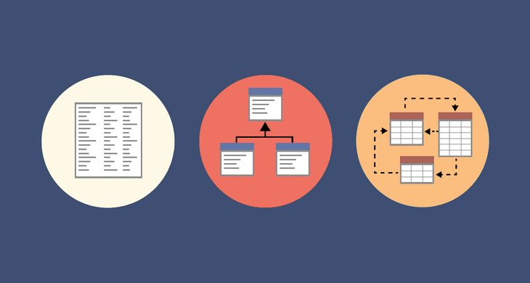

09
Data MODELING
We divided the column into five tables and all of these tables are related and connected to each other.
1st table contains (Supplier) :
Supplier i’d.
Supplier region.
Factory location

Slide 11
10
Data MODELING
2nd table (Product):
Product id.
Current stock.
Reorder point.
Warehouse location.

Slide 12
11
Data MODELING
3rd table (Shipping):
Shipping mode.
Delivery status.
shipping ID.

Slide 13
12
Data MODELING
4th table (Order):
Order id.
Order country.
Order city.
Order state.
Order region.

Slide 14
13
Data MODELING
5TH table (Customer):
Customer Id.
Customer segment.
Customer country.
Customer city.
Customer state
Fact table contains aggregate and id columns.

Slide 15



THANK YOU

